Slide 1
Oakville Hydro Case
By Jack & Yang

Slide 2
Problem statement
Oakville hydro is a company makes profit from selling electricity
There are 3 types of engine they can choose, each with a different rate and cost
En engine can only work when daily gas intake excess the minimum requirement and the annual working rate must be exceed 70%
A tank is offered to provide more daily intake gas by collecting previous excess gas at an initial cost of 50000
The project is trying to maximize the profit

Slide 3
Assumptions
Due to our data simulation model’s limitation. A few value is negative which would not happen in real life. We assumed those negative values to be zero for the ease of calculation.
Assumed the annual revenue remains the same in the 20 year period
Interest rate used in present value calculation is 9%
Assumed the daily gas intake data is normally distributed with mean of 13279 and standard deviation of 7070.
Assumed the yearly peak hour and off peak hour has a rate of 2080:6680

Slide 4
Model Development
Six Situations:
J312 no tank
J320 no tank
J420 no tank
J312 with tank
J320 with tank
J420 with tank
Calculate the net present value of profit for each situation and select the best plan

Slide 5
Data Generation
Use build-in function “NORMINV()” of excel to generate random numbers following normal distribution with mean of 13729 and standard deviation of 7070.
The formula is : NORMINV(RAND(),13279,7070)
As mentioned in the assumptions, this formula would give negative value. We changed these values into zero for better user understanding.
To simulated the gas flow pattern more accurately and avoid bias, we generated 3650 random numbers for each situation and calculated the working proportion of each case.

Slide 6
Model: No Tank
Write an if statement in excel to check if the daily gas intake exceeds the threshold. For example, for situation 1 (J312 no tank) if the first day gas intake is stored in cell A1 with a value of 9000, the formula will be: if(A1>8755,1,0)
Which returns a 1, meaning that the engine is working.
Count the total number of 1s, and divided by the total days of 3650 and get a working rate. The results are as follows:
J312 | J320 | J420
0.735 | 0.632 | 0.419

Slide 7
Model: No Tank
Although the working rate varies when using different random numbers, big changes in the results were not found. As a result, Assume that only J312 can achieve the required level of 70% working.
Calculate profit for no tank:
Revenue for each day: (0.1985*2080/(2080+6680)+0.1336*6680/(2080+6680))*24*rated output
Revenue for each year: daily revenue*365*working proportion
Calculate cash flow and find net present value using build-in function “npv” in excel.

Slide 8
Model: No Tank Calculation
For example,calculate the profit for J312 without tank.
The output is 847, so daily revenue is:
(0.1985*2080/(2080+6680)+0.1336*6680/(2080+6680))*24*847=3029
2. The working proportion in this case is 0.7482, so annually revenue is:
3029*0.7482*365=827240.7
3. Generate cash flow chart

Slide 9
Model: No Tank Cashflow
Here is the cash flow for first five years and it remains the same for the remaining 15 years. First year has installation cost and expected cost, rest only has maintaining cost (7% of expected cost). Then calculate the net present value of this cash flow use interest rate of 0.09 of each column and the final present value for profit= npv(profit)-npv(tank cost)-npv(machine cost)=4479784.09 in this scenario.
 | machine cost | tank cost | profit
1 | 2000000 | 0 | 821182.6
2 | 140000 | 0 | 821182.6
3 | 140000 | 0 | 821182.6
4 | 140000 | 0 | 821182.6
5 | 140000 | 0 | 821182.6

Slide 10
Model: With Tank
Define Variables:
Let’s say the daily gas intake value to be X
The current tank storage to be T
The working threshold to be A, For instance, 8755 for J312
The maximum tank value to be B, which is constantly 1855
A binary variable Y = 0 means can’t work, Y= 1 means can work

Slide 11
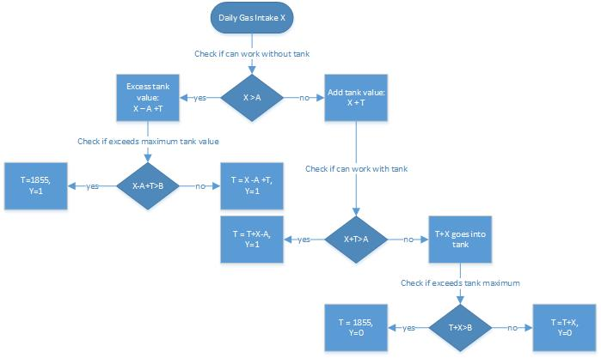
Model: With Tank Logics Flowchart

Slide 12
Model: With Tank Cont’d
Follow the flowchart, we can get five end points each returns a new tank value T and binary value of Y to represent if the engine will make profit that day. Only three T values will be reflect:
T1 when X>A, can work
T2 when X+T>A, can work
T3 when X+T<A, can’t work
However in excel, we are doing it a bit differently. We added a boolean value (0 for no and 1 for yes) for if X>A which stores in column D, T1 stores in column F, another boolean for if X<A in column G. T2 stores in column I and T3 stores in column K. Introduce a new T4 in column L when X+T>A, returns T2, Otherwise returns T3.

Slide 13
Model: With Tank Cont’d
Since X can only be larger than or smaller than A, the sum of value in column D and G will be 1. Therefore the new tank value will be value in D * T1+ value in G * T4. For example, the tank value at the start of day 2 is D1*F1+G1*L1.
To determine if the engine will work, add a new column N. The formula will be D1+if(I1>0,1,0). Since when D1 is 1, I1 must be 0 and the system is working; when D1 is 0, I1 can > 0 (working) or 0 (not working). Count the total number of the boolean value stores in N and divided by 3650, getting the following new rate:
J312 | J320 | J420
0.802 | 0.724 | 0.519

Slide 14
Model: With Tank Cont’d
Note that the rate is floating since our data is generated from random numbers, but the value will change much. Therefore, we know that J312 and J320 is qualified with a maximum tank volume of 1855.
We only need to calculate the profit of Situation 3 and 4 in this case.

Slide 15
Model: With Tank Profit Calculation
The profit calculation process is same as the no tank scenario:
Revenue for each day: (0.1985*2080/(2080+6680)+0.1336*6680/(2080+6680))*24*rated output
Revenue for each year: daily revenue*365*working proportion
Calculate cash flow and find net present value using build-in function “npv” in excel.
The results are as follows:
J316 | J320
$5137926 | $5300242

Slide 16
Sensitivity analysis: volume of the tank changes
$5,352,100.70
We found out that the tank can significantly increase the work rate to gain more profit, so we want to analyze the effect of tank volume change. Here we change the volume to 2500 and change its cost to 70000.
 | Work rate | profit
J316 1855 | 0.82 | $5,137,926.73
J320 1855 | 0.73 | $5,352,100.70
J420 1855 | 0.52 | -
J316 2500 | 0.84 | $5,334,821.25
J320 2500 | 0.75 | $5,508,945.24
J420 2500 | 0.54 | -

Slide 17
Sensitivity analysis: volume of the tank changes
From the table, we can see that increase the tank volume will bring much more profit even if the cost for tank is increased. However, to bring the work rate of J420 to 70%, the tank volume need to be at least 6000. We assumed the tank cost in this case is 200000 with volume of 6183 , then the total profit can achieve $8,281,498.30.
So we can conclude that if tank with larger volume has huge potential to incline the total profit, so ordering a big enough tank for a higher volume machine can be a great plan for the company.

Slide 18
Conclusion
In the given 6 scenarios, J320 with tank has the highest net present profit while meeting the working rate requirement, so we recommend the company to choose this option.
The gas flow of J420 is too high that a tank with volume larger than 6000 is required to meet the minimum working rate of 70%.If the requirement is achieved, J420 can produce much greater profit than other options.However, having a tank has such large volume is impossible, therefore choosing the J320 with a tank with reasonably higher volume is always recommended.

